Slide 1



Slide 2
Mentors & team details
Group-3
Ganesh
Naidu
Amit
Arati
Radha
Nandyala
Kartheek
B. pallavi

Slide 3
Business Objective
This is classification project, since the variable to predict (Bankruptcy or Non-Bankruptcy). The goal here is the model the probability that business goes bankrupt from the different features.

Slide 4
Data set details
Data: 250 companies with 7 features.
Features:
Industrial Risk
Management Risk
Financial Flexibility
Credibility
Competitiveness
Operating Risk
Target Variable:
Class
This project focuses on understanding the impact of different risks and business attributes on the probability of a company going bankrupt. The classification model will help in predicting bankruptcy based on these factors, aiding in better financial and operational decision-making.

Slide 5
Eda
1.IMPORTING THE REQURIED LIBRARIES
import pandas as pd
import matplotlib , pyplot as plt
import seaborn as sns
2. Checking missing data and outliers
3. Data encoding
4. Checking correlation

Slide 6
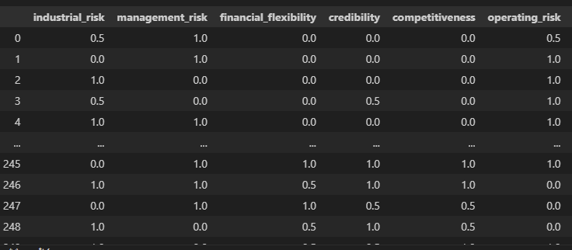
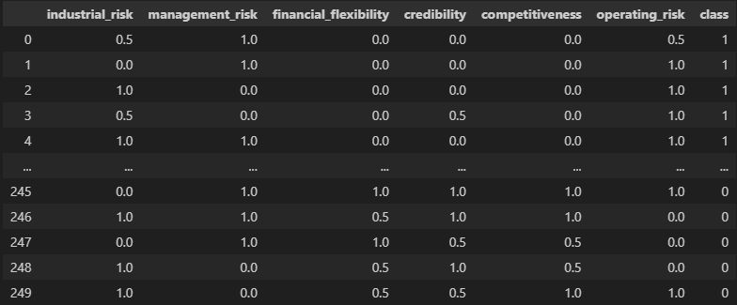
CONVERT ALL COLUMNS EXCEPT 'CLASS' TO FLOAT
INSPECT THE UNIQUE VALUES IN THE 'CLASS' COLUMN
CONVERT TARGET VARIABLE 'CLASS' TO BINARY

Slide 7
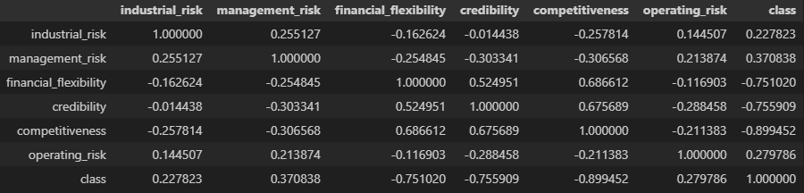
CORRELATION
df_split.corr()
Observations:
Companies with higher industrial and management risks tend to have lower financial flexibility, making them more vulnerable to financial shocks.
Financial flexibility enhances a company's credibility and competitiveness, indicating a strong market position.
Classification of companies is influenced by their credibility and competitiveness levels.
Positive Correlations:
Financial flexibility correlates positively with credibility (0.525) and competitiveness (0.687).
Industrial risk correlates positively with management risk (0.255).
Negative Correlations:
Financial flexibility correlates negatively with industrial risk (-0.163) and management risk (-0.255).
Credibility (-0.756) and competitiveness (-0.899) negatively correlate with classification.

Slide 8
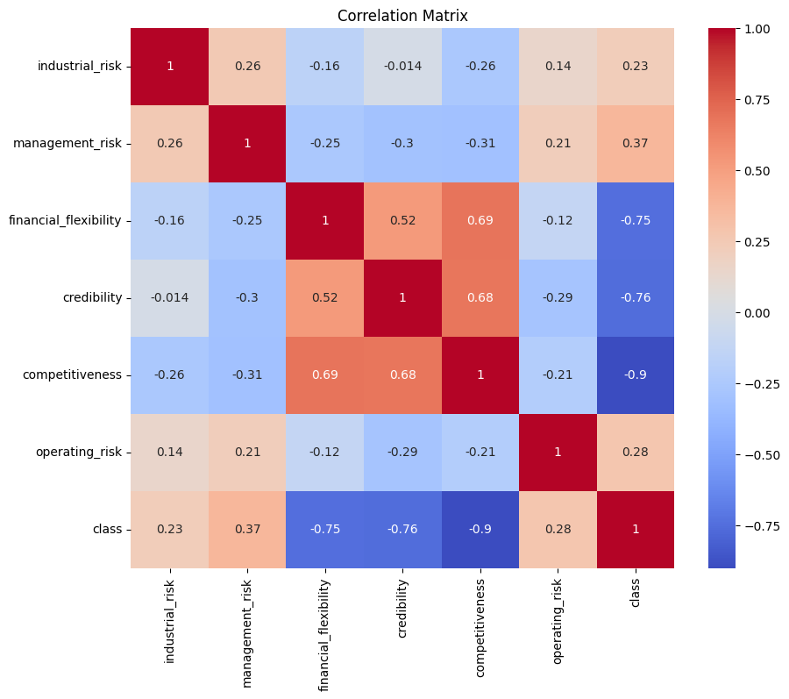
Data Visualization
CO-RELATION ANALYSIS:
Observation
financial_flexibility and credibility are strong predictors of competitiveness, suggesting that companies with higher financial flexibility of 0.69 and credibility tend to be more competitive with 0.68.
class is negatively correlated with competitiveness, credibility 0.68, and financial_flexibility 0.69, indicating that companies with a lower class rating tend to have lower competitiveness -0.9, credibility -0.76, and financial flexibility -0.75.

Slide 9
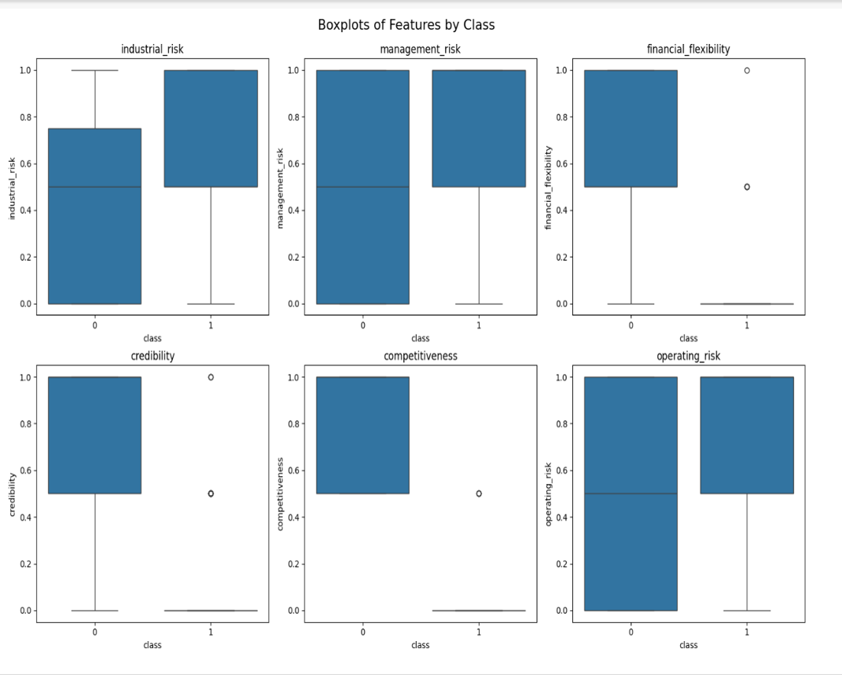
Box-Plot
Observation:
Industrial, Management, and Operating Risks by Class:
Bankruptcy Group [1]: Median value around 0.8 for all three risks; IQR between 0.6 and 1.0.
Non-bankruptcy Group[0]: Median value around 0.5 for industrial risk, 0.6 for management and operating risks; IQR between 0.4 and 0.8.
No outliers in either group.
Inferences:
Industrial Risk: Higher and more variable in the bankruptcy group 0.5 - 1.0; lower and more consistent in the non-bankruptcy group 0 - 0.75.
Management Risk: Higher and more variable in the bankruptcy group 0.5 - 1.0; lower and more consistent in the non-bankruptcy group 0 - 1.0.
Operating Risk: Higher and more variable in the bankruptcy group 0.5 - 1.0; lower and more consistent in the non-bankruptcy group 0 - 1.0.

Slide 10
Model Building
Accuracy score of each model
Logistic Regression Accuracy of the model is 100.0
Decision Tree Accuracy of the model is 98.0
Random Forest Accuracy of the model is 100.0
Gradient Boosting Accuracy of the model is 98.0
Support Vector Machine Accuracy of the model is 100.0
k-Nearest Neighbors Accuracy of the model is 98.0
Naive Bayes Accuracy of the model is 100.0

Slide 11
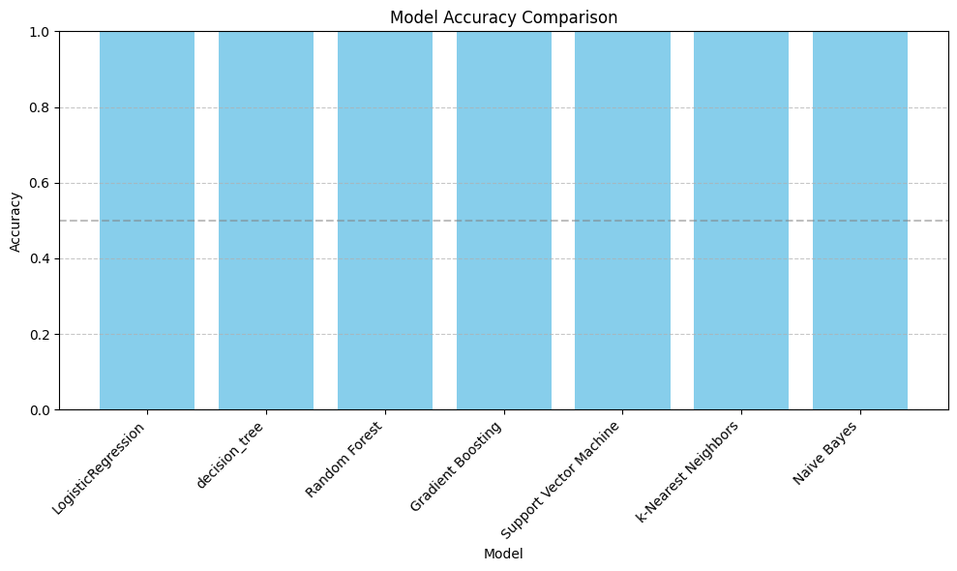
Box plot of model accuracies
Bar Plot:
All models achieved either 100% or 98% accuracy.
There are no visible variations in accuracy between models due to the limited range of accuracy

Slide 12
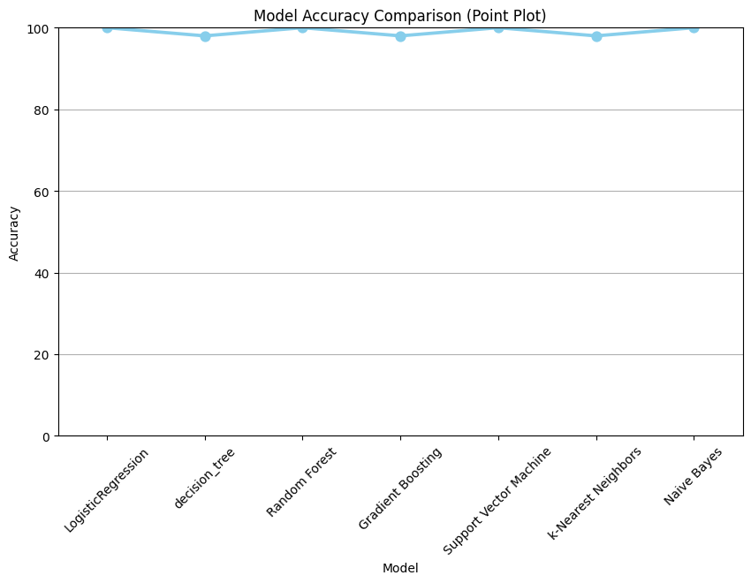
Point plot of model accuracies
Point Plot:
The point plot shows individual accuracies for each model. It's evident that most models achieved either 100% or 98% accuracy, with very few deviations from these values. Models with 100% accuracy are represented by points on the upper line, while models with 98% accuracy are on the lower line.

Slide 13
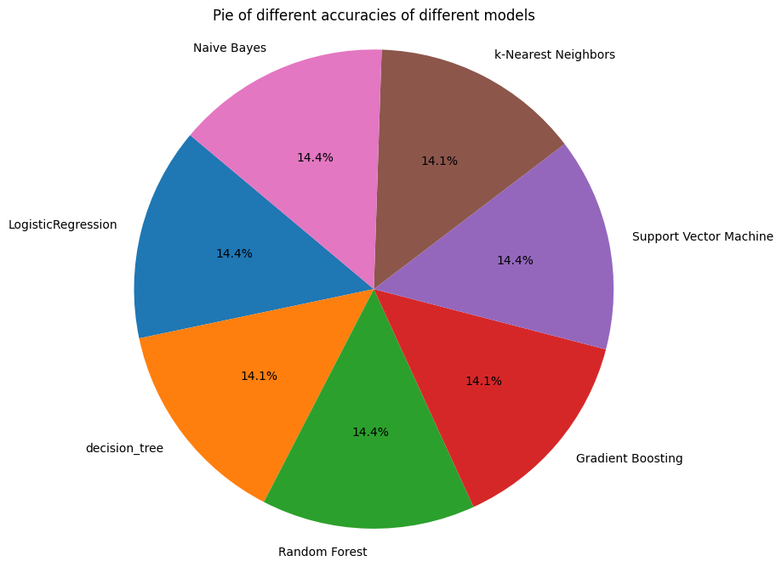
Pie chart of model Accuracies
Distribution of Accuracies:
Logistic Regression, Random Forest, Support Vector Machine, and Naive Bayes achieved 100% accuracy with higher proportion of perfect accuracy.
Decision Tree and k-Nearest Neighbors achieved 98% accuracy with significant portion of the overall accuracy distribution.
Most models achieved either 100% or 98% accuracy, leading to a balanced distribution across the pie chart.

Slide 14
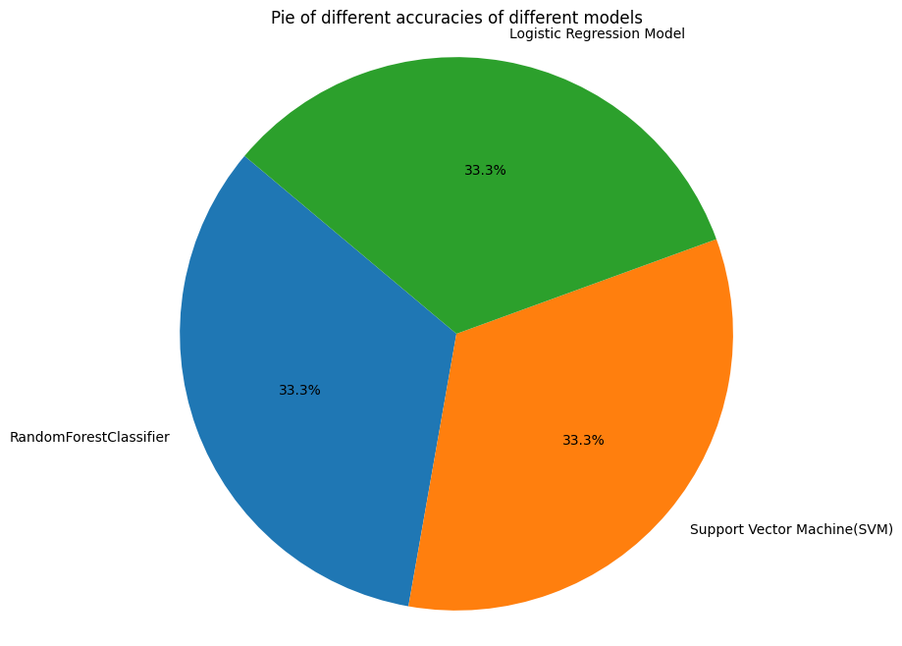
Effective Algorithms we considered for model building
Models which got 100 % accuracies we consider them for model building.
models we consider are with percentages.
random forest : 33.3%
logistic regression : 33.3%
support vector machine: 33.3%

Slide 15
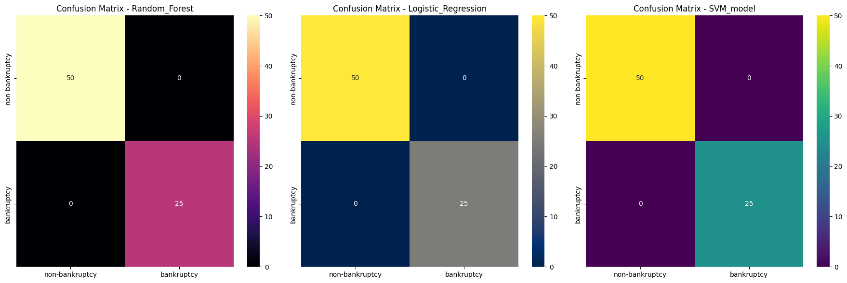
Random forest
Accuracy: 1.0
Confusion Matrix:
[[50 0]
[ 0 25]]
Classification Report:
precision recall f1-score support
0 1.00 1.00 1.00 50
1 1.00 1.00 1.00 25
accuracy 1.00 75
macro avg 1.00 1.00 1.00 75
weighted avg 1.00 1.00 1.00 75
Cross-Validation Accuracy: 1.00 ± 0.01

Slide 16
Logistic Regression
Accuracy: 1.0
Confusion Matrix:
[[50 0]
[ 0 25]]
Classification Report:
precision recall f1-score support
0 1.00 1.00 1.00 50
1 1.00 1.00 1.00 25
accuracy 1.00 75
macro avg 1.00 1.00 1.00 75
weighted avg 1.00 1.00 1.00 75
Cross-Validation Accuracy: 1.00 ± 0.01

Slide 17
Support Vector Machine
Accuracy: 1.0
Confusion Matrix:
[[50 0]
[ 0 25]]
Classification Report:
precision recall f1-score support
0 1.00 1.00 1.00 50
1 1.00 1.00 1.00 25
accuracy 1.00 75
macro avg 1.00 1.00 1.00 75
weighted avg 1.00 1.00 1.00 75
Cross-Validation Accuracy: 1.00 ± 0.01

Slide 18
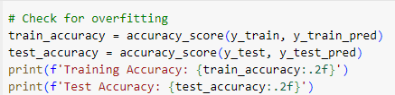
Check for over fitting
Training Accuracy: 0.99
Test Accuracy: 1.00

Slide 19
Feature Importance (Data)
 | Random Forest | Logistic Regression | SVM
industrial_risk | 0.017673 | 0.462343 | 0.927254
management_risk | 0.028724 | 0.834791 | 0.822815
financial_flexibility | 0.192287 | -2.159445 | -2.430869
credibility | 0.236721 | -2.308794 | -1.712487
competitiveness | 0.501340 | -3.665228 | -4.697089
operating_risk | 0.023255 | 0.430639 | 0.305326

Slide 20
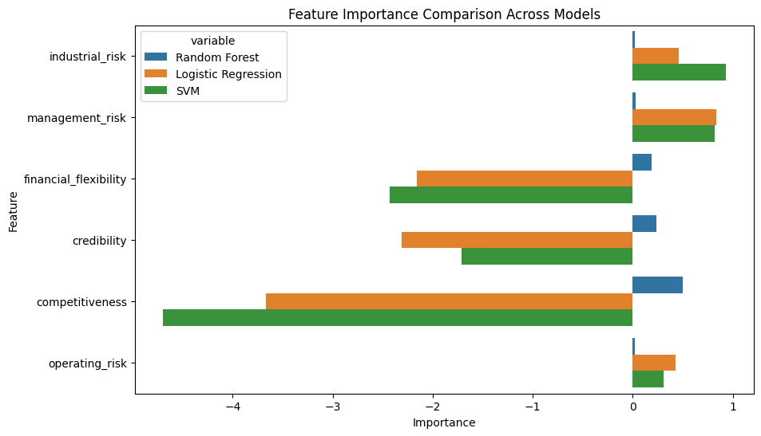
Feature importance Visualization

Slide 21
Inferences
Industrial Risk:
Random Forest: Has very low importance with [0.018].
Logistic Regression with [0.462] and SVM with [0.927]: Positive importance, moderately high.
Management Risk:
Random Forest: Low importance [0.029].
Logistic Regression and SVM: Highest positive importance among all features [0.825].
Financial Flexibility:
Random Forest: Moderate importance with [0.192].
Logistic Regression with [-2.431] and SVM with [-2.159]: Negative importance, indicating it decreases the probability of bankruptcy.
Credibility:
Random Forest with [0.237] : Moderate to high importance .
Logistic Regression with [-1.712] and SVM with [-2.309] : Negative importance.
Competitiveness:
Random Forest [0.501] : Highest importance.
Logistic Regression with [-3.665] and SVM with [-4.697] : Most negative importance.
Operating Risk:
Random Forest [0.023] : Low importance.
Logistic Regression with [0.431] : Positive importance, moderately high.
SVM (Linear) with [0.305] : Moderate positive importance.

Slide 22
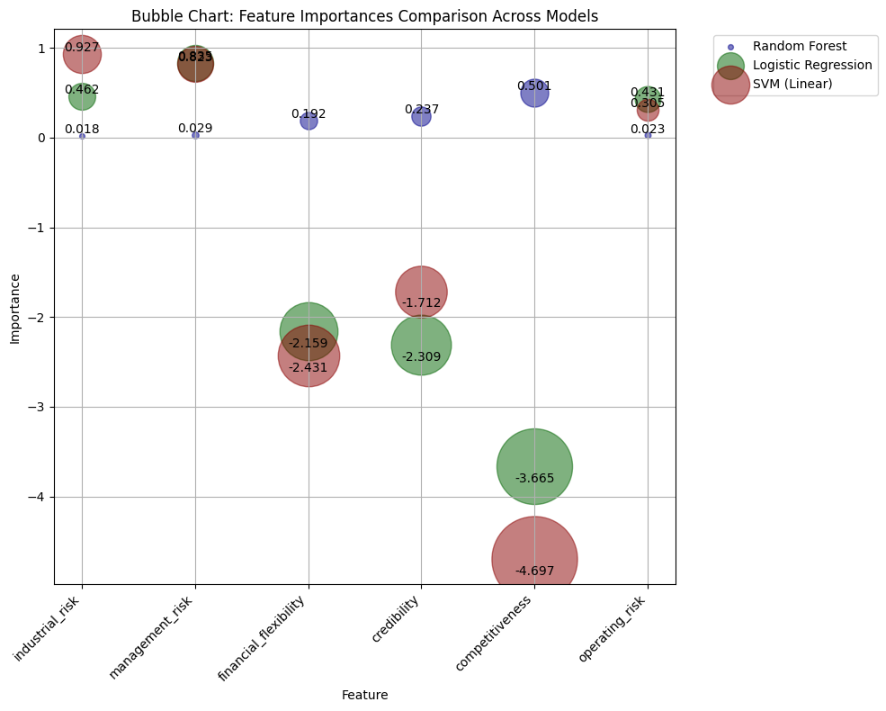
Bubble Chart: Feature Importances Comparison Across Models
Conclusion:
Random Forest emphasizes Competitiveness.
Logistic Regression and SVM emphasize Management Risk.
Features like Financial Flexibility and Credibility show a negative impact on the probability of bankruptcy in Logistic Regression and SVM.

Slide 23
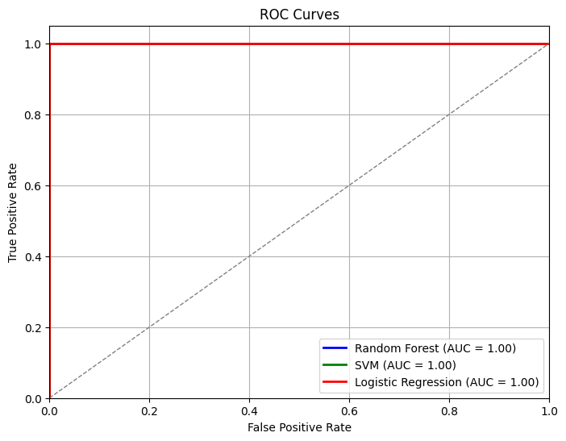
ROC Curves of Models (Random forest, SVM, Logestic regression)
It is showing straight line because all three modules accuracy is 100% and there are no false positives or false negatives at any threshold, resulting in a perfect ROC curve.
If all models have 100% accuracy, the ROC curve will be a diagonal line from (0,0) to (1,1) with an AUC of 1.

Slide 24
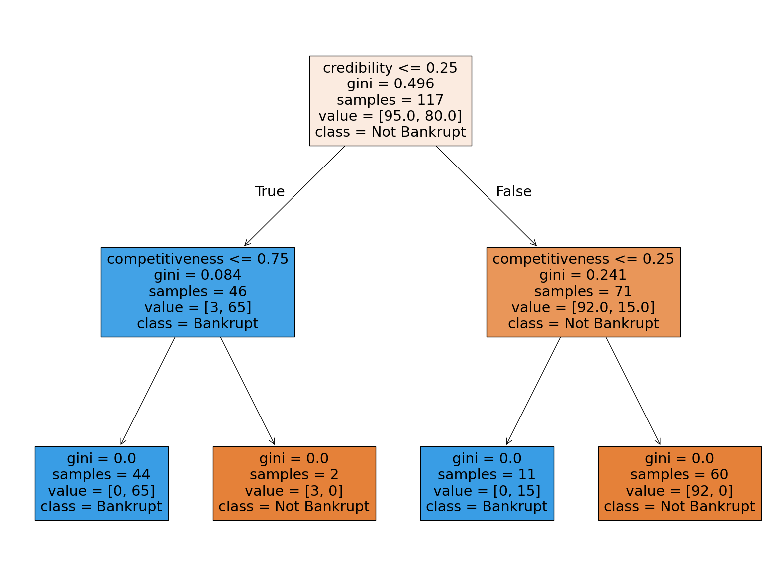
Decision Tree
Credibility is the first criterion for splitting the data.
If credibility is less than or equal to 0.25:
Then, competitiveness is checked.
If competitiveness is less than or equal to 0.75, the majority of samples are classified as Bankrupt.
Otherwise, a small number of samples are classified as Not Bankrupt.
If credibility is greater than 0.25:
Then, competitiveness is checked.
If competitiveness is less than or equal to 0.25, the majority of samples are classified as Bankrupt.
Otherwise, the majority of samples are classified as Not Bankrupt.
This decision tree effectively classifies the samples into Bankrupt and Not Bankrupt categories based on the values of credibility and competitiveness

Slide 25
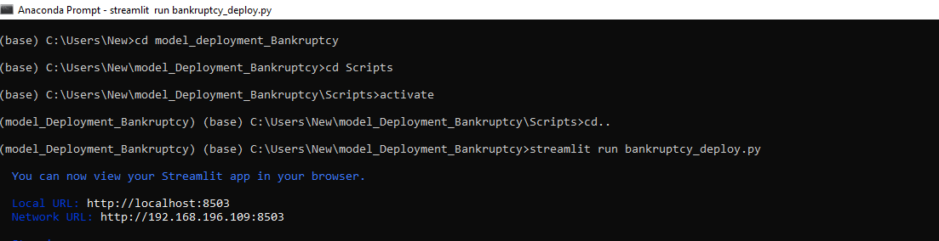
Execution of app file
Steps for execution
Open command prompt. change the directory of the file location
Run the file using command streamlit run “file path”

Slide 26
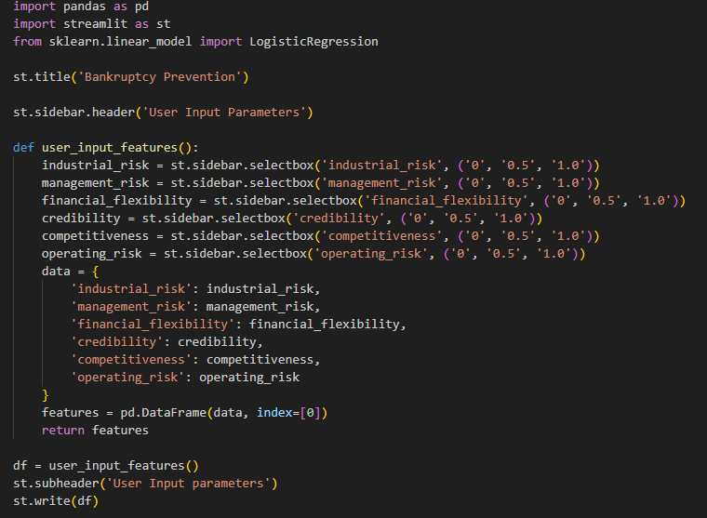
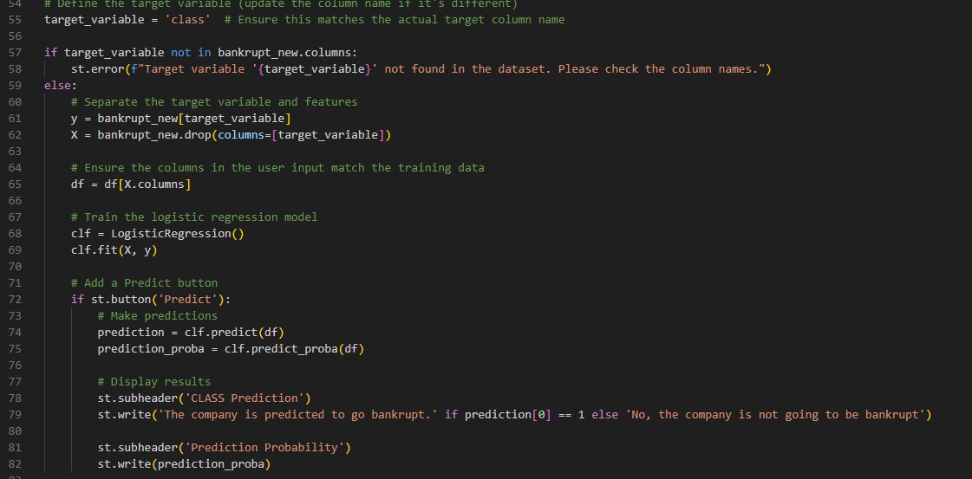
bankruptcy-prevention_web_app
Streamlit Setup: The app uses Streamlit for the UI and has fields for entering various features relevant to bankruptcy prediction.
Model Loading: The trained model is loaded using pickle.
Prediction Function: The predict function takes features as input, reshapes them, and uses the model to make a prediction.
Main Function: The main function sets up the app interface, collects user inputs, and displays predictions based on the input values.
Model File Path Handling:Ensure the model file (Trained_model.sav) is in the correct directory where the Streamlit app is running.You might want to handle the file path more dynamically or add error handling if the file is not found.

Slide 27
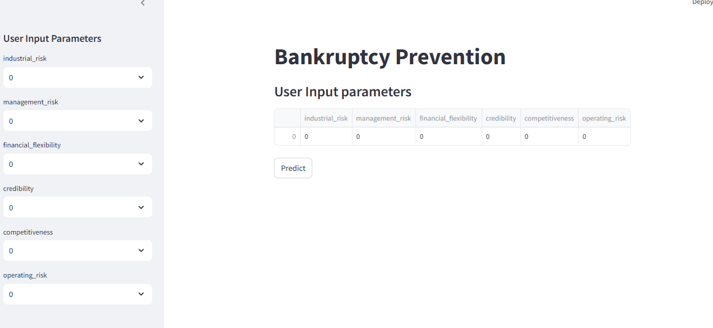
Model evaluation
Instructions: "Enter the details to predict bankruptcy:".
There are several input fields for users to enter numerical values corresponding to different risk factors:
Industrial
Management Risk
Financial Flexibility
Credibility
Competitiveness
Operating Risk
Each input field starts at 0.00, with plus and minus buttons to adjust the values. At the bottom, there is a "Predict" button to submit the entered data for prediction.

Slide 28
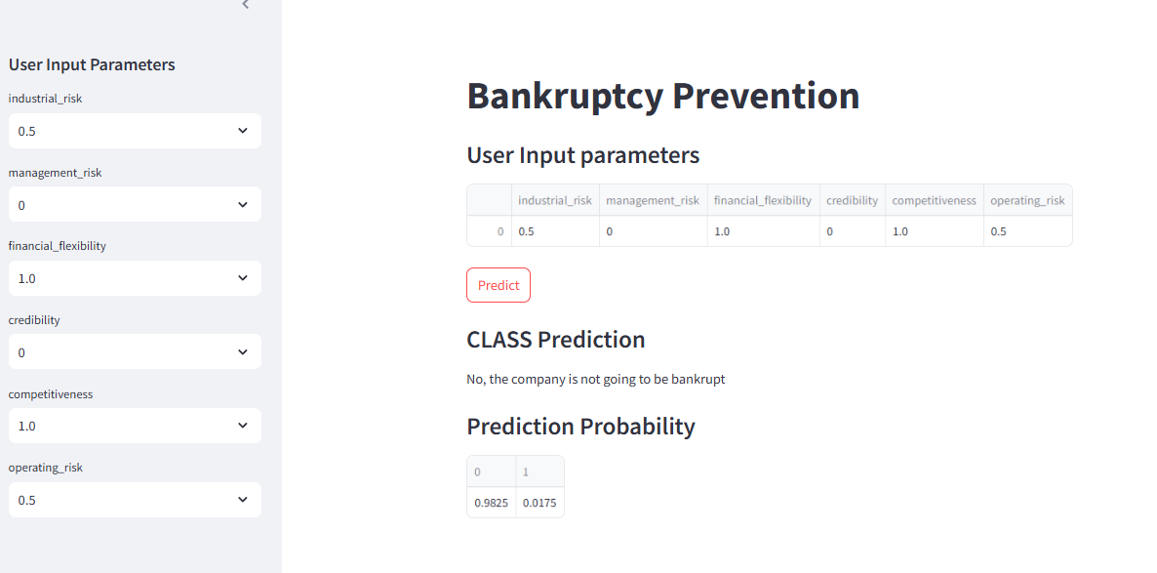
Model evaluation (random values)

Slide 29

Data-Related challenges
Data Imbalance:
The dataset might have a significant imbalance between bankruptcy and non-bankruptcy cases, which can make it difficult to train models effectively. This often leads to models that predict the majority class more accurately while ignoring the minority class.
The challenges faced for bankruptcy prediction project in data science are numerous.One of the primary challenges is dealing with imbalanced datasets, where the number of bankrupt companies is significantly lower than the number of non-bankrupt companies. This can lead to biased models that favor the majority class.
Soln : Undersampling the majority class (non-bankrupt companies) to reduce their impact on the model
Feature Selection:
Determining which financial ratios or indicators are most predictive of bankruptcy can be challenging. While dataset includes features like industrial risk, management risk, financial flexibility, credibility, competitiveness, and operating risk, not all of these might be equally important.
Feature selection is also a crucial challenge, as the dataset consists of financial data points, and not all of them may be relevant to predicting bankruptcy. Selecting the most important features can improve model performance and reduce overfitting
Soln : So we use correlation analysis to identify features highly correlated with the target variable (bankruptcy) Use techniques like Correlation Analysis, Feature Importance, or Dimensionality reduction to select most informative features and improve model performance.
Outliers:
The presence of outliers in dataset, as seen in your boxplots, can affect the performance of some models. Identifying and handling these outliers appropriately is crucial.

Slide 30
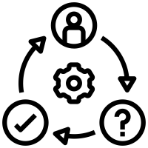
Modeling Challenges
Model Selection:
Choosing the right algorithm that balances performance and interpretability. While Random Forest provided high accuracy, simpler models like Logistic Regression might offer more interpretability.
Model selection is another challenge: as different models may perform better or worse depending on the dataset. In this case, decision tree, random forest, and gradient boosting models were used, and their performance was evaluated using training and validation accuracy
Solution : So We Used combination of models (e.g. Decision Tree, Random Forest, Gradient Boosting) and evaluate their performance using metrics like training and validation accuracy to select the best model for the dataset.
Overfitting:
Given our models achieved 100% accuracy, there's a high chance of overfitting. Ensuring that the models generalize well to unseen data is critical.

Slide 31

Evaluation Challenges
Cross-Validation:
Cross-validation (cross_val_score) with cv=5 in the code assesses model performance robustly by training on 5 different subsets of data and testing on the remainder. It addresses overfitting concerns and evaluates model stability via mean and standard deviation of scores, ensuring reliable performance estimation across varied dataset partitions.
Confusion Matrix Interpretation:
Interpreting confusion matrices to understand model performance beyond accuracy, especially in the context of imbalanced classes.
We use a confusion matrix to evaluate the performance of a classification model by comparing predicted outcomes to actual outcomes.
It provides a summary of correct and incorrect predictions, allowing us to calculate metrics like accuracy, precision, and recall. This helps to identify errors, such as false positives and false negatives, and improve the model's performance.

Slide 32

Technical Challenges
Visualization:
Visualizing feature importance's and model performance in an informative way. For example, ensuring bubble charts are clear and interpretable.
Model Integration:
Integrating these models into a pipeline that can handle new data inputs and provide real-time predictions if needed.
Different technical backgrounds: Team members may have different technical backgrounds, making it challenging to communicate complex ideas and concepts.
Solution:
We overcomes from this using clear and concise language to explain technical concepts in the group
By Encouraging active listening and open communication
Assigning tasks based on individual strengths and expertise
We Established a common goal and working together to achieve it
By addressing these specific challenges and observations, we can refine your bankruptcy prediction model to be more robust and reliable.

Slide 33


